Slide 1
You received a popular computer game for your birthday. When your friends found out, they asked you to burn a copy for them. What is the ethical dilemma you face and what do you tell your friends?
What Are the Legal Issues?
What is the source of morality and ethics?
Should ethical decisions be based on a person’s feelings or opinions?
Do ethical and legal issues ever conflict?
Do ethical standards ever change?
Does the law ever change in the United States?

Slide 2
Defining Ethics
What You Will Learn:
How ethical decisions are made
When to apply the greatest good principle
When to apply the golden rule principle
How to explain the nature of ethical character traits
When the law relates to ethics
How to explain the importance of law
How ethics and the law might sometimes conflict
Why It Is Important:
Learning how to apply ethical principles will help you make ethical decisions

Slide 3
How Ethical Decisions Are Made
Difference between right and wrong
People use different methods
Conscience
Rules
Religious Teaching
Professional Code of Conduct
Parents
Three ways to make ethical decisions
Morality – involves the values that govern a society’s attitude toward right and wrong.
Ethics – are the means for determining what a society’s values ought to be.

Slide 4
Feelings and Opinions
Right and Wrong may be a matter of opinion
Can change depending on feeling or opinions
Example: Harriet is from a poor family, Frank is from a wealthy family. Harriet believes that Frank has more money than he needs. When Frank leaves his backpack unattended, Harriet steals it. She defends her actions by saying that she needs the backpack and that Frank can buy another one.
Harriet’s actions hurt Frank and set a bad example for others.

Slide 5
The Greatest Good
Every action has the potential to affect others
The more good that results, the more ethical the action
Example: Alame knows that 10 of her 20 classmates cheated on the last exam. The teacher mistakenly believes that only one innocent student is guilty of cheating. Alame decides she will keep silent because doing so will ensure the greatest good for the greatest number of people
Misapplied !
Notes:
This where the greatest good has been misapplied . Her failure to identify the ten guilty student helps on the cheaters. She has also not considered the unethical example that her decision will set for the whole school or how the decision may affect the school’s academic standards.
Her decision to keep quiet is not fair to the innocent students, who must take the blame for the guilty parties.
Discuss Seat belt laws in light of the greatest good principle:
Does it infringe on an individual’s rights, the live of many people are saved because of wearing them
Slippery slope:
If ethical standards are flexible and constantly changing, then no one could ever be accused of doing anything wrong and all sorts of questionable behavior could be justified

Slide 6
The Golden Rule
“ do unto others as you would have them do unto you”
Consistency and universal appeal
Empathy – putting yourself in someone else’s position
Good sportsmanship is a form of the golden rule
Example: Steve, a pitcher, gets frustrated and throws two pitches at the other teams’ best batter. The umpire ejects Steve from the game. The coach tells Steve, “you were wrong, If it is right for your to throw at their batter, then it would be right to them to throw at our batters”.
Notes:
The golden rule has been adopted by many of the world’s major religions for two reasons:
First, it respects the dignity and worth of individuals. Secondly, people want to be treated with respect

Slide 7
Appears easy to follow but it can offer difficulty and can be open to abuse.
Example: Stan was judging a debate where he gave Abby a better grade than she deserved. He knew that she would be judging his debate and was expecting her to do the same for him.
Treating and gaining respect
Example: Your older sibling goes into your room and borrows things without permission. You get laughed at when you approach them about it, because they don’t want to take orders from someone younger than them.

Slide 8
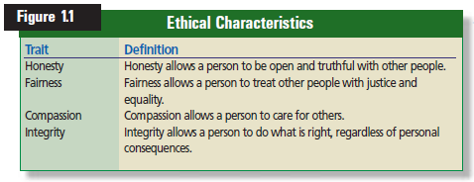
Ethical Character Traits
Notes:
Fairness can be paired with the word Justice.

Slide 9
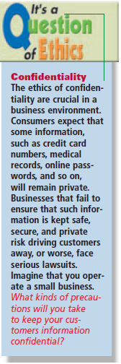
Relationship between Ethics and Law
If the three ways always reached the same ethical result, laws would not be needed.
Certain types of behaviors are immoral and wrong
Just because we deem something immoral doesn’t mean that it has been eliminated from our society

Slide 10
Why the Law is Necessary
Law is the system of rules of conduct established by the government of a society to maintain stability and justice
Example: World Cars, Inc. advertises its cars by saying “They’re the best on the market!” even though it know that they are quite ordinary. A competitor, Best Auto Corp, uses a similar slogan, but its car violate safety laws and are frequently involved in accidents
World Cars is ethically dishonest but not illegal. Best Auto makes shoddy cars which is illegal

Slide 11
Laws define legal rights and duties of the people
Enforced through agencies, courts, legislature and regulatory agencies.
Laws can’t make people do what is right
Laws have the power to punish for wrong behavior

Slide 12
Example: You see a blind man standing at a busy intersection who needs help getting across the street. You do nothing. Someone else comes along and thinks it would be funny to push him into the street.
Your ethics would make you stop and help.
The law will punish the idiot who pushed him into the street.
Laws draw the line between acceptable and unacceptable actions

Slide 13
Ethical and Legal Conflicts
Laws are made by people, people are imperfect
Ethics and law still conflict
Example: Clark is the editor of the high school newspaper. Rita tells Clark that another student is selling drugs on campus, but asks Clark not to reveal his source. When the article appears and the student is arrested, Clark has to testify at the trial. He refuses to identify his source and is held in contempt of court.
Upheld the ethics of journalism, but refused to obey an order from a judge
Notes:
2

Slide 14
Reviewing What You Learned
How are ethical decisions made?
How can the greatest good principle lead to ethical decisions?
How can the golden rule principle lead to ethical decisions?
What are the four ethical character traits?
How is the law related to ethics?
Why is the law important?
How might ethics and the law conflict?

Slide 15
Ethical Situation
Last week you misplaced your new iPhone. You thought you may have left it in the locker room after practice. After looking everywhere for it, you posted a reward notice on the bulletin boards around school. The next day, a student sees you in the hallway and hands you your iPhone and say “I found this in the library. Good thing you had your name on it”. Even though he did not mention the reward, are you still obligated to pay it? Is it ethical not to pay the reward to the finder?

Slide 16
Sources of Law
What You Will Learn:
How to recognize the various parts of the U.S. Constitution
How to explain the components of common law
How to explain the purposes of statutory law
How to identify the various ways that courts make law
How the government makes administrative regulations
Why It Is Important:
Learning how the law is made will help you make decision regarding your legal responsibilities

Slide 17
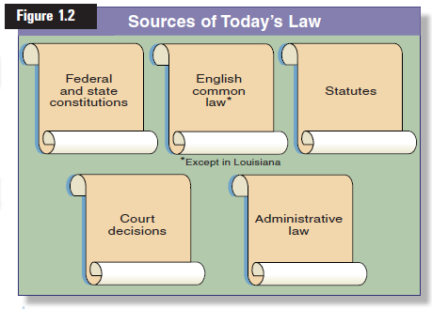
The Five Main Sources of U.S. Law

Slide 18
Constitutional Law
A country’s constitution spells out the principles by which the government operates.
The Constitution of the United States
Sets forth the rights of citizens
Defines limits by which government operate
Defines functions of the branches and divisions of government

Slide 19
The U.S. Constitution
Seven Articles
Article I – Legislative Branch
Article II – The Executive Branch
Article III – The Judicial Branch
Article IV – Relations among States
Article V – The Amending Process
Article VI – National Supremacy
Article VII – the Ratification of the Constitution
27 Amendments
1 – 10 are called the Bill of Rights

Slide 20
The Constitution
Seven Articles
Articles I, II & III set the structure and powers of the three branches of the federal government
Article IV requires each state to accept the laws of other states
Article V outlines how the constitution may be changed
Article VI contains the supremacy clause
Article VII ratification of the constitution - 1787

Slide 21
Amendments – 27 of them
First 10 are known as the Bill of Rights
Ratified in 1791
Limit the power of government
Protect the rights of individual liberties
Protect the rights of someone accused of crimes
Amendment 14 is known as the equal protection clause
Major principle of justice
States to give protections outlined in the 5th amendment

Slide 22
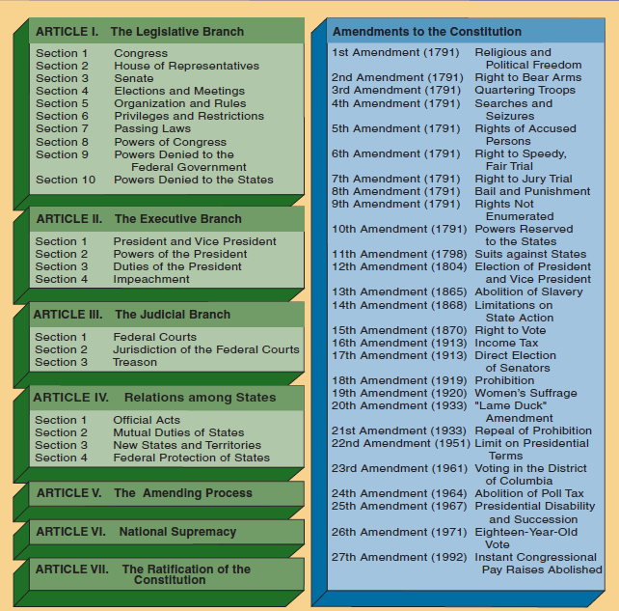

Slide 23
Federal vs. State Constitutions
States must provide the same rights as the federal government gives in the Fifth Amendment
They are similar, but can be more protective, or restrictive than the federal
Example : Being denied admission to a school based on gender. In 1982, the supreme court held that single sex admission policy violated the equal protection clause of the 14th amendment
Example : The state of Massachusetts wanted to have a graduated income tax, but their state constitutions requires that all people are to be taxed at an equal percentage

Slide 24
Common Law
Rooted in English common law except Louisiana, which is French
Traveling judges
No written law
Made decisions based on customs and traditions
Shared decisions with other judges
Thus, creating “common law”
Then decisions were written down
Judges could then refer to past cases
Thus, creating “precedent”

Slide 25
Under the doctrine of precedent, judges were required to follow earlier decisions
Stare decisis - “let the decision stand”
State statutes and court decisions in the US eroded English common law.
Parts of common law still exist today in some states.

Slide 26
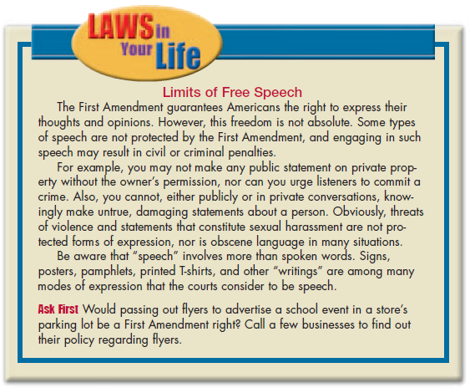

Slide 27
Statutory Law
Statutes are created to declare the law in issues and circumstances.
Paying taxes
Selective service
Prevent discrimination
Legislature – a body of lawmakers, that has the job of creating statutory law under the powers of Article 1

Slide 28
Federal Statutes
Laws passed by congress and signed by the president
Power to spend, tax and borrow money
Regulate commerce between states
May have become more powerful than intended
May not pass laws than conflict with the constitution
Supreme court to determine unconstitutionality
State Statutes
Each state has its own legislature
Names may be different
Functions are the same
May not pass laws that conflict with the U.S. Constitution

Slide 29
Court Decisions
When courts make laws it is referred to as “case law”
Common Law tradition
Interpreting statutes
Judicial review
Decisions become law, then are followed by other courts in the state
Judges may have to interpret statutes when they are confusing, incomplete or unclear.
Courts also decide if laws or government activities are consistent with the Constitution

Slide 30
Administrative Regulations
Government find it desirable to regulate certain types of activities by creating agencies
FCC – broadcasting
EPA – environment
FTC – trade and commerce
Possess a wide range of powers – administrative law
Make rules
Enforce rules
investigate violations

Slide 31
Reviewing What You Have Learned
What are the various part of the U. S. Constitution?
What are the components of common law?
What are the purposes of statutory law?
How do the courts make law?
How does the government make administrative regulation?

