Slide 1
Laws Relating to Employment Conditions & Benefits
What You Will Learn:
How to recognize the role that OSHA play in ensuring workplace safety
How to identify employers’ legal requirements with regard to wages and hours
How to identify the statues designed to protect employee privacy rights
How to distinguish between unemployment compensation and workers’ compensation
Why It Is Important:
Understanding the rights that are legally due to employees will help you determine your rights

Slide 2
Employment Condition
Industrial Revolution
Employers demanded a lot but gave a little in return
Health and Safety
OSHA (Occupational Safety and Health Administration)
It was put into place in 1970 by Congress
Business that have 11 or more employees must follow these acts/laws
OSHA uses two approaches
Employer has to maintain a safe and health working environment
Creates rules outlined the safety steps that businesses must maintain

Slide 3
Wages, Hours, and Benefits
Many of these Acts went into place due to the sufferings of the workers in the Great Depression
Fair Labor Standards Act (Wage and Hour Law)
Employers pay employees a legal minimum hourly wage rate plus time and half for over 40 hours
Professional Employees, administrators, and executives not covered by this act (salary employees)
Equal Pay Act
Pay women the same rate of pay as men holding the same type of job
Commissions should be the same rate

Slide 4
Pension Plan
Provide income to the employer after he/she retires
Amount is based on the amount of the employee’s salary and years working for the company
Employment Retirement Income Security Act (ERISA)
Employee contributions to pension plan in a trust fund
Yearly reports on the amount of money in the plan
Family and Medical Leave Act
Employee is entailed to 12 weeks of leave during any 12 month period for birth of child or to care for a immediate family member

Slide 5
Employee Privacy Act
Federal Privacy Act
Government employees are given the right to restrict inspection of their employment files, be informed of the contents of the files, and fix any mistake in the files
Drug-Free Workplace Act
Employees and applicants are required to notify of the testing procedure
Companies have to keep the results confidential
Employee Polygraph Protection Act
Employers cannot give one in an interview or just in random

Slide 6
Laws Providing Worker Benefits
Protects workers who have left the job due to retirement, injury, or disability
Social Security Act
Government program that provides limited income to workers and their dependents due to disability or retirement
Contributions by both employers and employees
In order to receive, you must put into the social security

Slide 7
Unemployment Compensation Laws
Government payments to people who are out of work and looking for a job
Workers are disqualified if they refuse suitable work, fired for misconduct, or quit their jobs without cause
Workers’ Compensation Laws
Worker’s compensation is an insurance program that provide income for workers who are injured or develop a disability or disease as a result of their job
Employers pay the cost

Slide 8
Worker Opportunity Laws
Welfare – assistance to the poor Americans who have children
TANF – must hold a job or be in school or he/she will face a loss of payments
If minor, the person must be in a house with an adult

Slide 9
Reviewing What You Learned
Why is it important to ensure employee safety in the workplace?
What legal requirements are placed upon employers with regard to wages and hours?
What federal statues are designed to protect employee privacy rights?
What is the difference between unemployment compensation and workers’ compensation?

Slide 10
Laws Regulating Employment Discrimination
What You Will Learn:
How to define discrimination
How to identify the objective of the Civil Rights Act
How to identify the goal of the Age Discrimination in Employment Act
How to explain the mission of the Americans with Disabilities Act
Why It Is Important:
You need to know the laws that outlaw employment discrimination to be able to identify instance of discrimination

Slide 11
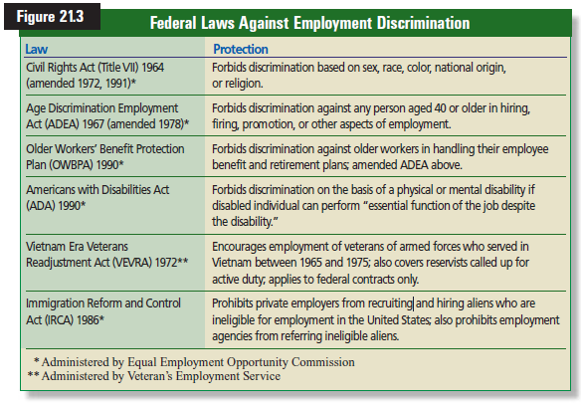
Discrimination
Civil Rights Act of 1964

Slide 12
Discrimination
Unequal treatment of individuals based on sex, age, race, nationality, or religion
The Civil Rights Act of 1964
Prohibits discrimination in employment when related decisions are made
Based on Race, Religion, Color, Gender, or national origin
Equal Employment Opportunity Commission (EEOC)
Has the power to stop unfair employment practices by getting a court injunction or by suing for damages

Slide 13
Disparate Treatment
Employer intentionally discriminates against an individual or group who belong to a protected class
“We do not hire male nurses” is an example
Defense is called Bona fide occupational qualification (BFOQ)
Example it is justified that women only model female bathing suits. Cannot ever be used for race.

Slide 14
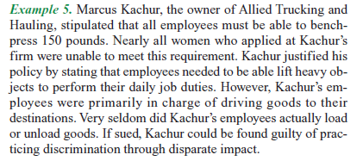
Disparate Impact
Indirect discrimination – policy appears neutral but has an unfair impact
Example - Employer who only hires people who are over six feet tall
Business Necessity
Requirement to perform the job

Slide 15
Civil Rights Act of 1991
Strengthen the doctrine of disparate impact
People from any of the 5 categories were able to receive money if discriminated – used to be only race
Sexual Harassment
Quid pro quo harassment
One worker demands sexual favors in exchange for something
Hostile working environment
Sexually demeaning behavior in the workplace
Pregnancy Discrimination Act
Cannot fire or not promote someone who is pregnant

Slide 16
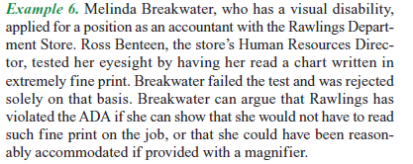
Age Discrimination in Employment Act (ADEA)
Forbids discrimination against anyone that is 40 and above in hiring, firing, and promotions
Americans with Disabilities Act
Disability – physical or mental disability that limits their major life activities

Slide 17
Reviewing What You Learned
What is discrimination?
What is the objective of the Civil Rights Act of 1964?
What is the mission of the Americans with Disabilities Act?

