Slide 1
Chapter Objectives
Define communication
Explain why effective communication is an important management skill
Explain the significance of networking and social media in management communications
Understand why it is still possible to communicate poorly
Understand the challenges of communication in international business activities

Slide 2

Communication
  What is communication
    Simply the act of exchanging information

Slide 3
  Communication as a Management Skill
  Giving direction
    Good direction leads to a job well done
  Motivate people
    Getting others to be excited about their work
  Customer relations
    Little or no communication skills = no sales
  Absorb ideas of others
    Understanding & accept viewpoints of others
  Persuade others
    Get others to accept their ideas

Slide 4

Interpersonal Communication
Notes:
Communication from managers to subordinates is critical in achieving organizational objectives

Slide 5

  Interpersonal communication
  An interactive process between individuals
  Verbal and nonverbal

Slide 6

  Conflicting or Inappropriate Assumptions
    Feed back changes how the message is delivered
    Open to interpretation
    Messages differ by sender
      Stop / Do this right now / Please don’t
Notes:
Sound communication usually flows from ensuring theat the sender and the receiver see and understand assumptions in the same way.

Slide 7
FIX
  Semantics
    The study of meaning of words and symbols
    Words interpreted differently to different people and how it’s used
      Facial expressions
      Hand gestures
      Voice inflections
    ACRONYMS and abbreviations
Notes:
The word fix:
Fix a drink = mix
Fix a flat = repair
Fix a speeding ticket = nullify
Fixed position = unchanging
I’ll fix you = revenge
In a fix = in a hard place

Slide 8
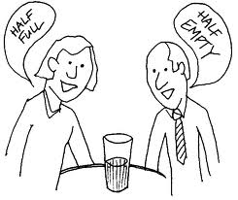
  Perception
    Deals with the mental and sensory interpretation of information received
    Perception is unique
    A message can be received differently
    Selective perception
    Only listen to what you want to hear

Slide 9
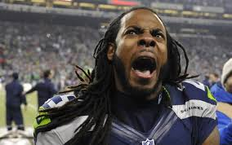
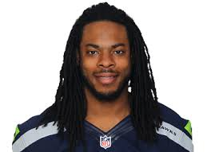
  Emotions Either Preceding or During Communication
    Your emotion affect your disposition
    Your disposition is the foundation for communication

Slide 10

Learning to Communicate
  Understanding the Audience
    What do they already know?
    What do they want to know?
    What is their capacity to absorb the information?
    What do they hope to gain by listening?
    Are they hostile or friendly?

Slide 11
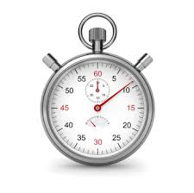
  Developing Good Listening Skills
    Are you a good listener?
      Are you open to what other people say to you?
      Do you make up your mind before you hear their views?
      Do you become bored when others speak?
      Do you interrupt when others are speaking?
      Do you daydream during meetings?
      Do you hesitate to ask clarifying questions?
Notes:
Actively listening:
The average listener only retains 50% after 10 minutes
Only 25% after 48 hours
Only 10% after about 5 days

Slide 12
    Using active listening
      Listening
      Responding
      Ensuring satisfaction
      Identify the speaker’s purpose
      Identify the speaker’s main ideas
      Note the speakers tone and body language
      Respond with appropriate comments, questions, and body language
    Feedback
      Lets the sender know if they delivered a message that was understood
Notes:
Identifying the speakers purpose:
What are they trying to achieve, why are they speaking
Identifying their main idea
What are the key points
Which points need to be addressed by the listeners
Tone and body language
Is the speaker angry, nervous, confident?
Responding
Non verbal - facial expressions and body language
Eye contact
Feedback:
Sender should request that the receiver explain what they heard

Slide 13

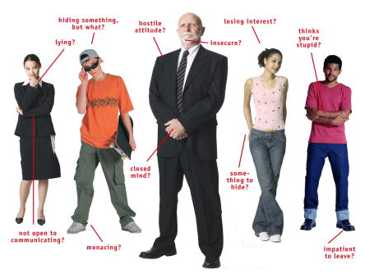
  Understanding the importance of nonverbal communication
    Eye contact
    Facial expressions
    Level of voice
    How you are dressed
    The way you walk
  Non-verbals are read during interviews

Slide 14
Written Communication
  Principles of good writing
    Write as simply and clearly as possible
      Write as you would speak, not above to impress
    Content and tone in line with audience
      Use a polite tone as well as respect their time
    Proofread your document
      Spell-check is your friend
      Good grammar is a must
      No texting jargon – if U no what I mean
    Purpose / Audience / Main Message
Notes:
Purpose:
Why am I writing this document
What action do I want the reader to take
Audience:
Who will read this?
How much do they already know about this subject?
How will the reader use this document
Writer should be aware of special circumstances
Main message:
What is the main message that the writer wants to deliver
How will they support the message

Slide 15
Write and wrong
We plan to work closely with our foreign partners
Interfacing with foreign counterparts is likely to continue in the future at an accelerated pace.
Sales were weaker than management had expected
Sales were terrible this year!
The marketing department decided to create two new brochures
The decision was made to create two new brochures
Everyone in our company does their best to increase company profits
Ever man in this company does his best to increase company profits

Slide 16

  MEMOS
    Most used method of office communication – in the form of an email
    Staff changes
    Sharing new ideas
    Report on developments
    Must include
      To:
      From:
      Date:
      Subject or Re: (regarding)

Slide 17
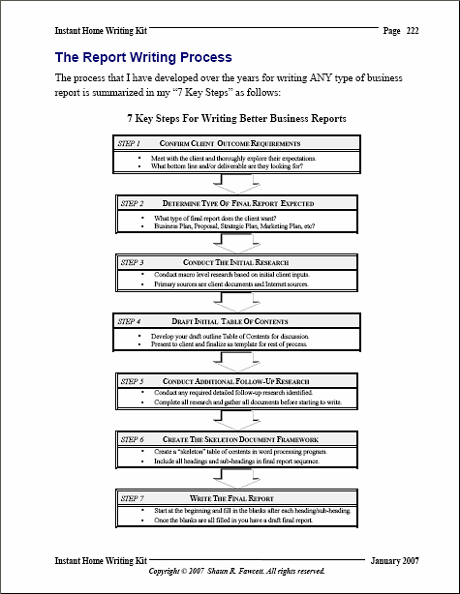
  REPORTS
    Documents that provide information on a certain topic.
  Used to make decisions
  Develop strategies
  Solicit actions
PURPOSE
AUDIENCE
MESSAGE

Slide 18
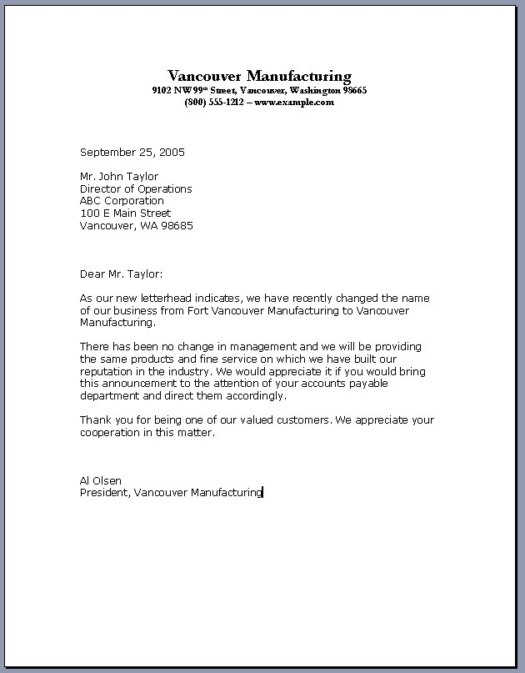
  LETTERS
    Short and concise
    Usually a thank you or an introduction
    Printed on letterhead
  Must include:
    Date
    From
    Dear …..
    Sincerely
    Name and Title

Slide 19

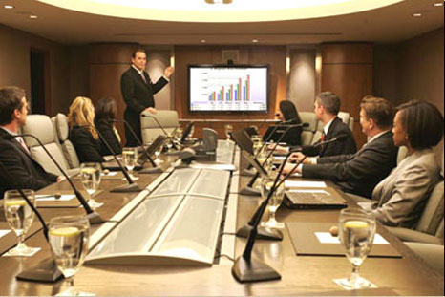
Oral Communication
  Most business communication is done orally
    Informal
      Hallways
      Kitchen
      Cafeteria
      Telephone
    Formal
      Meetings
      Interviews

Slide 20
Importance of Oral Communication
  Managers use this for:
    Giving clear instructions
    Motivating their staff
    Persuading others
  An effective communicators can set the tone for the department
  Open door vs closed door policy

Slide 21
Developing Oral Communication Skills
  Effective speaking takes practice
    Emotional contact
      Use names and eye contact
    Avoid monotone
      Use variations to emphasize words and points
    Be positive
      Point out what is going well not wrong
    Do not interrupt
      Even if you know what they are going to say
    Be courteous
      Even if you disagree
    No “um”, “ah”, “like”, “you know”.

Slide 22
Choosing the best method
  Master both and use them as the situation calls for it. Some require BOTH
Verbal
  Sensitive topics
  Reprimanding
  Dismissing
  Recognizing work
Written
  Policy changes
  Staff changes
  Future actions
  Routine information

Slide 23


Communicating within the Organization
  The Grapevine
    Very informal, rumors, ever present
    Sometimes very accurate
  E-Mail
    The electronic version of the memo
  Intranet
    Web pages only available from inside the company
Notes:
Grapevine got it name from how the telegraph lines were strung from tree to tree
They were very garbled and rumors were said to be from the grapevine
Form on a social level – hobbies, lunch breaks, family ties
Management must use it to compliment the formal channels of communication
Honesty is the best policy and can be used to stop the spread of rumors

Slide 24

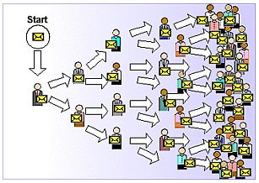
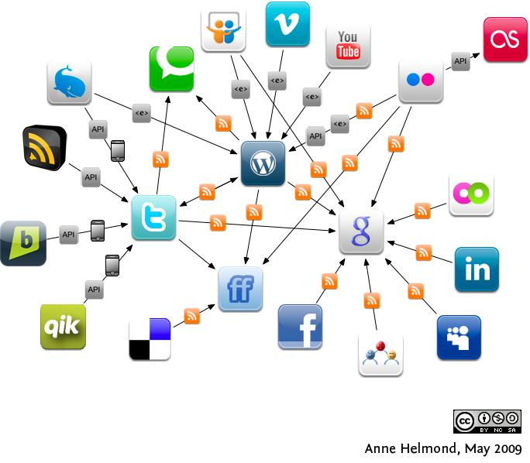
Networking
Notes:
Computer networking has exponentially expanded the old adage of a happy customer will tell 3 or 4 people but an unhappy one will tell 10.

Slide 25
Poor Management Communication
    Hoarding information
    Last minute assignments
    Last minute decisions with no input
  “Six Secrets of Top Performers”
    Focus on the customer
    Engage Employees in the Business
    Improving management communication
    Manage change effectively
    Evaluating communication programs
    Establishing a strong employee brand

Slide 26
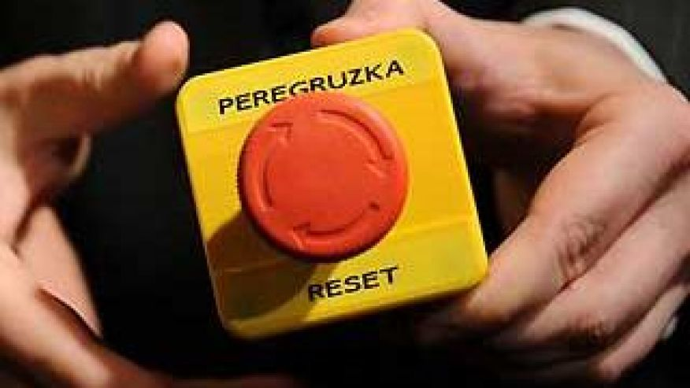
Communication in International Business Activities
  Complicated communications
    3000 languages
    Non verbals
    Personal space
    Hands
    Eating
    Gifts
    Jargon/Slang
    Peregruzka vs Perezagruzka (overcharged vs reset)
Notes:
Secretary of State Hillary Clinton learned that lesson the hard way Friday when she presented Russian Foreign Minister Sergei Lavrov with a gift bearing an incorrect translation -- one that implied hostility, rather than peacemaking.
Clinton presented Lavrov with a gift-wrapped red button, which said "Reset" in English and "Peregruzka" in Russian. The problem was, "peregruzka" doesn't mean reset. It means overcharged, or overloaded.
And Lavrov called her out on it.
"We worked hard to get the right Russian word. Do you think we got it?" Clinton asked Lavrov.
"You got it wrong," Lavrov said. "This says 'peregruzka,' which means overcharged."
The two top diplomats, who met in Geneva, laughed and Clinton explained: "We won't let you do that to us, I promise."
Clinton said earlier she was presenting the gift because it "represents what President Obama and Vice President Biden and I have been saying and that is, 'We want to reset our relationship.' And so we will do it together."
Clinton adviser Philippe Reines said the typo would be fixed, noting that the correct translation for "reset" is only a couple letters off.
"Since we're all learning a little Russian today, Opechatka is Russian for typo. So the 'Opechatka' is being fixed, the gift will correctly read 'Perezagruzka,'" he said.

Slide 27
