Slide 1
What is a Crime?
What You Will Learn:
How to tell the difference between serious and less serious crimes
How to explain the difference between state and federal criminal law
How to explain the elements of a crime
How to define the various defenses to criminal liability
Why It Is Important:
Learning the essence of criminal law, the types of crimes that can be committed, and the nature of criminal defense will help you understand our criminal justice system

Slide 2
Classifications of Crimes
    A crime is an act against the public good
    Laws detail crimes and provide punishments
  Felonies
    Major crimes that are punishable by imprisonment or death
    Murder, manslaughter, burglary, robbery, and arson
  Misdemeanors
    Less serious crime with a less severe penalty
    Driving w/o a license, leaving the scene of an accident
    Petty offenses like traffic tickets and parking violations
Notes:
In criminal law the plaintiff is the government – local, state or federal
The prosecutor is the govt lawyer
The accused is called the defendant
Some states call felonies high misdemeanors

Slide 3
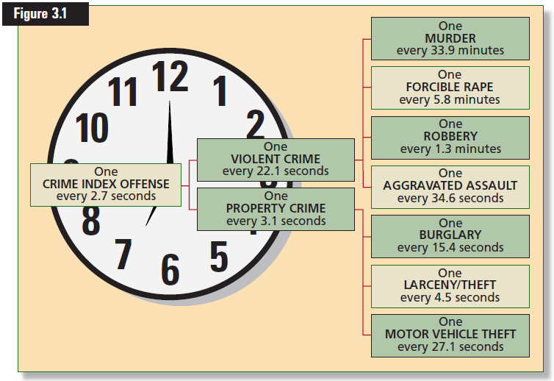

Slide 4
Criminal Law in the American System
    Consists of two systems
  State Criminal Law
    State has inherent police power
    Makes statutes to protect the public health, safety, welfare, and morals
    Closely resemble each other
    Definitions and penalties may differ from state to state
    Assault in one state may be called battery in an other

Slide 5
  Federal Criminal Law
    Has no criminal code or police power
    Can only create statutes over which it has jurisdiction
      Counterfeiting
    FBI and DEA are agencies created from the commerce clause in the US Constitution
    Treason is one crime named and defined in the US Constitution
      Confession or two witnesses required to convict
    Double Jeopardy
      Tried twice for the same action but in different courts

Slide 6

Elements of a Crime
  Made up of two elements
  Criminal Act
    An act that is forbidden, like stealing
    A failure to act, like registering for the service
    Must involve voluntary conduct
    Accusation can not be based on physical or mental condition
Notes:
Stealing is an act that is defined at the wrongful taking of another person’s personal property.
Govt can not make being an alcoholic a crime because it is a physical condition, but it can have laws regarding at what age a person can consume alcohol.

Slide 7

  Required State of Mind
    Murder vs Manslaughter
    Murder comes with the INTENT
    Manslaughter is ACCIDENTAL
  Motive
    Plays ABSOLUTELY NO part in proving criminal liability
Notes:
A statute defining murder forbids the intentional taking of a person’s life: the required mental state is intent.
Manslaughter is defined at the accidental taking of a person’s life.

Slide 8
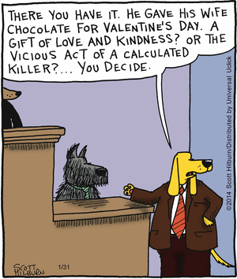

Slide 9
Defenses to Crime
    Defense attorneys try to show failure to prove required elements for the crime.
  Insanity
    The law recognizes that people can not be held responsible for their actions when they do not know what they are doing
  Entrapment
    When law enforcement officers induce someone to commit a crime.
      Example – several students told their teacher that a student offered to sell them drugs. She reported it to the police and they sent an undercover officer to the school. The student was arrested when they tried to sell drugs to the officer. Not entrapment because the student would have told the drugs anyway.
Notes:
Insanity must be proven
must be so serious that they did not know the inappropriate nature of the crime they committed
The American Law Institute developed a test for insanity.
A person is not considered responsible if “ as a result of mental disease or defect he or she lacks substantial capacity either to appreciate the criminality of his conduct or to conform his conduct to the requirements of law.”
3/5ths of the states follow this test.
A not guilty decision does not mean that someone goes free – most are committed to institutions and undergo psychiatric exams

Slide 10
  Self-Defense
    People can use force to protect themselves – must have good reason to do so.
      Must have attempted retreat
      If happens in their own home, no need for retreat
      Must show that they did not start the altercation
      Must show that they did not use excessive force to stop the attack

Slide 11
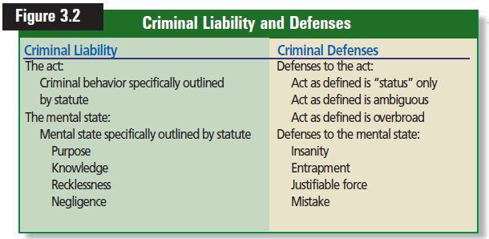
  Defense of Family Members
    Most states will not punish actions of force used to rescue family members
      Rescuer must have a good reason

Slide 12
Reviewing What You Learned
  What determines the difference between a felony and a misdemeanor?
  How do state and federal criminal law differ?
  What are the elements of a crime?
  What are the major criminal law defenses?
Notes:
Felonies are more serious than misdemeanors and are distinguished by longer, more severe penalties
State govts have inherent police power. Making criminal law statues is a part of this police power. The federal govt has no police power, and can create criminal statutes only in those areas over which it has jurisdiction.
The act and the required state of mind.
Insanity, entrapment, self-defense, and defense of family members

Slide 13
Particular Crimes
What You Will Learn:
How to define major crimes against people
How to define major crimes against property
How to define major crimes that involve controlled substances
How to define major crimes that involve computers
Why It Is Important:
Learning how to distinguish among various crimes will help you understand criminal liability

Slide 14
Crimes Against People
  Murder
    The unlawful killing of another human being with malice aforethought or intent
      First-degree – thinking about or planning in advance
      Second-degree – if no certain conditions apply
  Manslaughter
    The unlawful killing of an other human being WITHOUT malice aforethought
      Voluntary – intent / suddenly / upset
      Involuntary – accidental with no intent
Notes:
Crimes can be grouped in three categories
Crimes against People
Crimes against Property
Crimes against business interests
Killing of a human being by another is known as homicide
Justifiable homicide
Police kills a criminal in the line of duty or in self-defense
when a soldier kills the enemy in battle
Excusable homicide
when someone is killed by accident
First degree conditions include
killing in a cruel way
while committing a felony
Distinction is important because some states guilty convictions are subject to the death penalty
Voluntary Manslaughter is when one person intends to kill another, but does so suddenly and as a result of great personal stress.
Example 3
Involuntary Manslaughter is when someone is unintentionally killed by an unlawful or reckless act
Example 4
If drag racing were a felony, then they would have been charged with murder
A killing that takes place during a felony is murder

Slide 15
  Assault and Battery
    Assault – is the attempt to commit battery
    Battery – involves force by hand or weapon
      Requires criminal intent or reckless behavior
    Simple vs. Aggravated
Notes:
Assault
Pointing or shooting a gun at someone is the assault – hitting them with the bullet is the battery
Battery can include:
giving poison or drugs to an unsuspecting victim
spitting in someone’s face
commanding a dog to attack
kissing someone who does not want to be kissed
Accidently bumping into someone is not battery – no intent
Simple assault and battery are generally misdemeanors
Aggravated assault and battery are felonies in most states
to be aggravated, the offense would have to be committed with a deadly weapon or with the intent to murder, commit rape, or robbery

Slide 16
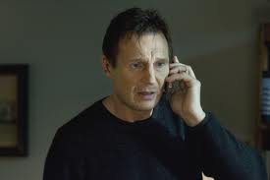
  Kidnapping
    Is the removal or restraint of a person against their will
    Imprisonment for ransom, torture, rape or to commit a felony

Slide 17
  Sex Offenses
    Male forcing a female to have sex
    Male having sex with an underage female
    Today, includes other types of sexual misconduct
    Statutes defining rape do not specify the age of the offender
    Date or acquaintance rape
    Victims are physically, emotionally and psychologically
    Sex offenses have very serious penalties
Notes:
Rape of a minor carries life in prison.

Slide 18
  Domestic Violence
    Is any reckless form of physical or mental abuse within a family or household.
    Child endangering and child abuse statutes
      Laws in place to protect and/or move children
      Punishment for the abusers
    Spouses are protected and have places they may go.
      Protective orders enforced by the local police

Slide 19
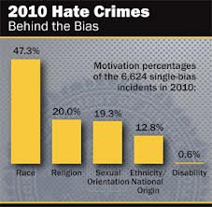
  Hate Crimes
    Use of symbols, writing, pictures, or spoken words to cause fear
    Actions are referred to as hate crimes or hate speech
      Statutes drafted narrowly – must not specify the content
    Legislature can pass a statute that outlaws language or symbols that rouse fear or outrage

Slide 20
Crimes Against Property
  Can be classified as felonies or misdemeanors, depending on the severity

Slide 21
  Burglary
    Defined as the breaking and entering of a dwelling house at night with the intent to commit a felony
      Expanded to include daytime and places other than homes and with the intent of a misdemeanor.
      If any part of the definition can not be proven, the defendant cannot be found guilty
    Example - Todd was jogging by a house with a partially open window. He raised the window and climbed in and stole a pair of shoes. A neighbor saw him and called the police, who then arrested him and charged him with burglary.
Notes:
Example
By common law definition, a court would find Todd not guilty because there was no breaking.
Most states now say that lifting a closed or partially open window is considered breaking

Slide 22
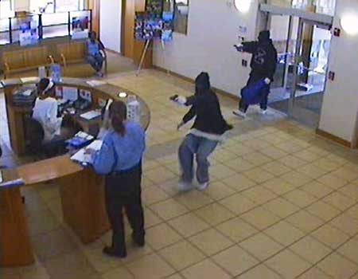
  Larceny
    The legal term for stealing
      Petty or Grand depending on the value of the property taken - $300 is the magic number
  Robbery
    The taking of property by force
    Carries a greater penalty
    Example – someone comes into a store, points a gun at the cashier and demand money. This would be considered armed robbery.
Notes:
It can be difficult to tell the difference between burglary, robbery and larceny.
Burglary is when a person enters a place with the intent of committing some kind of crime.
Robbery is when someone takes or tries to take something from a person with a threat or by force.
Larceny is like burglary but in that case, the person doesn't illegally enter a building. An example of larceny would be . shoplifting.

Slide 23
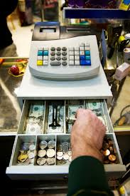
  Embezzlement
    Is defined as the taking of property by a persons who has been trusted with that property
      Example – Virginia worked as a cashier. A customer bought groceries with cash. Virginia put the money in her pocket instead of the cash register.

Slide 24

  Arson
    Defined as the willful and malicious burning of the dwelling house of another.
      Expanded to include all buildings
      Building must have been in flames

Slide 25
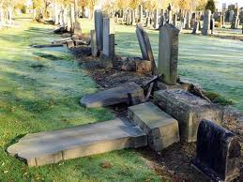
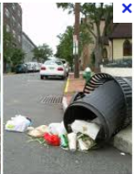
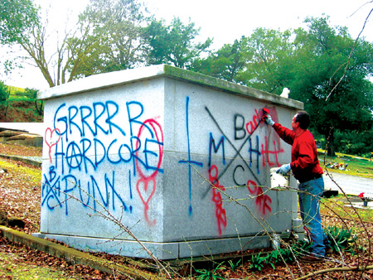
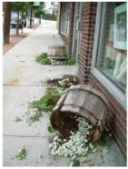
  Vandalism
    Is the willful or malicious damage to property
      May also be called malicious mischief or criminal damaging
      A “lookout” can also be charged

Slide 26
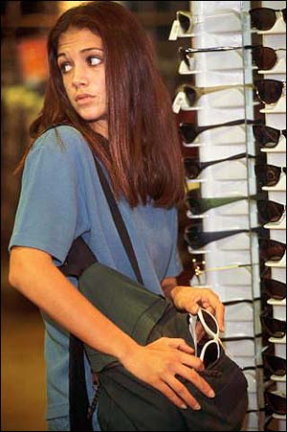
  Shoplifting
    Defined as the act of stealing goods from a store.
    Severity depends on the value of goods stolen
      Some states you can be charged with stealing before the act is completed.
    Costs consumers billions each year

Slide 27
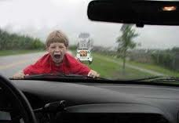
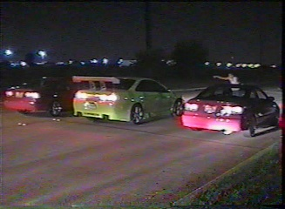
Motor Vehicle Violations
  Young drivers who break traffic laws are not offered special protections as juveniles
  Drag racing and joy riding – all who participate are liable
Notes:
Drag racing is the racing side by side or separately on a timed course
Joy riding is the unauthorized use of someone’s car

Slide 28
Crimes Involving Controlled Substances
    Alcohol and tobacco may be considered drugs because they are not legal for teenagers or children
  Alcohol
    Most commonly used drug in America
    Seller could be convicted if they sell to an underage person
      Loss of license, fined and/or imprisoned
    The underage person may also be charged for making an illegal purchase
  Drugs
    Chemicals that alter the functions of the mind and body.
Notes:
Possession, distribution, or sale of certain drugs may violate a federal law, state law or both.
Each state has its own punishments
Selling carries a greater penalty and possession
It is also a crime to give drugs away

Slide 29
Computer Crimes
    There are specific statutes that address the new legal problems involving computers
  Federal Crimes and Laws
    Mail fraud, wire fraud
    The Computer Fraud & Abuse Act
      Aimed at hackers
    National Information Infrastructure Act
      Aimed at extorting money in exchange for not causing a computer system to crash
  State Crimes and Computers
    A crime to use a computer to commit a crime
Notes:
State crimes and computers
An offense to use a computer to acquire property, services or money by fraud.
Some states have a detailed list of the computer related crimes.
Theft of computer services
Destruction of equipment
Misuse of computer information

Slide 30
Reviewing What You Learned
  What are the major crimes committed against people?
  What are the major crimes committed against property?
  What are the major crimes that involve controlled substances?
  How have states dealt with computer crime?
Notes:
Murder, manslaughter, assault, battery, kidnapping, sex offenses, domestic violence, hate crimes
Burglary, larceny, embezzlement, robbery, arson, vandalism, shoplifting
Those associated with alcohol and drugs
Creation of the crime of computer trespass, which outlaws the use of a computer to commit any crime; passed computer fraud statues, which make it an offense to use a computer to acquire property, services, or money by fraud.

