Slide 1
Intentional Torts
What You Will Learn:
How to tell the difference between a crime and a tort
How to explain the nature of tort law
How various torts can be committed
How to define various intentional torts
Why It Is Important:
Learning the difference between a tort and a crime, as well as the types of intentional torts, will help you understand how the justice system protects people from injury

Slide 2
Differences between Criminal Law & Tort Law
Crime
Act committed against the public at large
From speeding to murder
Is a criminal act
Tort
Act committed by one to another
Is civil – never criminal or based on a contract
Usually involves money or awarded damages
Notes:
A crime harms individuals and the general welfare
Role of government is to preserve the safety and well being of the entire social structure
A crime is considered an offense against the public at large and is punishable by the government
A tort is a private wrong committed by one person against another – one’s interference with one’s rights
Tort law is the part of law for most harms that are not either criminal or based on a contract. For example, a car accident where one driver hurts another driver because he or she was not paying attention might be a tort. If a person is hurt by someone else, he or she can sue in court.
Many torts are accidents, like car accidents or slippery floors that make people fall down and get hurt. But some torts are done on purpose. These are called intentional torts. For example, if one person punches another person in the nose, it might be an intentional tort called battery.
Many torts cause physical harm to people. Some torts cause damage to property, like a broken window. Some torts can harm other things, like someone's reputation or a business.

Slide 3
Intentional Torts
Occurs when a person knows or desires the consequences of his actions
In criminal law wrongdoings are calling crimes
In civil law wrongdoings are called torts
Notes:
Intentional torts
When a defendant causes an injury on purpose, that injury is an intentional tort. Sometimes, an injury can be an intentional tort if the defendant knows it will happen, even if the defendant does not want it to happen. Intentional torts include hitting people and saying things about them that are not true.

Slide 4
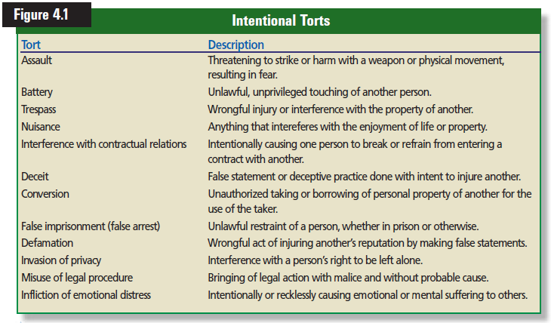

Slide 5
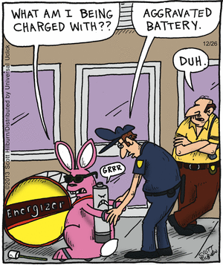
Assault and Battery
Two separate torts – the threat and the action
Difference between the crime and the tort
Notes:
ASSAULT & BATTERY - can be a crime, tort or both. In a tort assault and battery, the victim must know that the defendant (tortfeasor) tried to harm them.
How is the tort of assault and battery different than the crime of assault and battery? In a civil tort assault and battery, the victim must have known that the defendant (tortfeasor) tried to harm them.
Prior knowledge of an assault and battery is not needed in a criminal case.

Slide 6
Trespass
Is the wrongful damage to or interference with the property of another.
Personal and Real Property
Nuisance
Anything that interferes with the enjoyment of life or property
Notes:
Trespass Example – hunting on someone’s land without permission – even if NO damage is done
Air Rights – common law stated that property rights extended down to the center of the earth and up into the space above. Laws were rewritten to limit the airspace above, thus to not interfere with air travel.
Nuisance can be deemed private or public
private is when the nuisance only affects one person – barking dogs
public is when the nuisance affects many people – loud bar

Slide 7
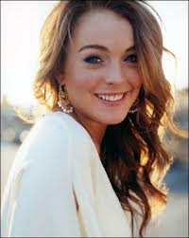
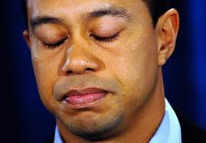
False Imprisonment
Law enforcement must have probable cause or a warrant to arrest someone
Shoplifting determining “reasonable” can be difficult
Defamation
The act of injuring another’s reputation by making false statements
Libel and Slander
Notes:
Example #3
DEFAMATION - the wrongful injury of another's reputation by the making of false statements. Defamation is divided into two categories: Libel and Slander. 1) LIBEL - a false statement that is damaging to a person's reputation. The statement is communicated to a third party via a written document or other mass media forms. A person can speak the truth, as long as it is not done with spitefulness or ill will. 2) SLANDER - damaging oral communication to a third party.
People in the public limelight (politicians, sports figures, moving stars) have more difficulty proving damage than the average person.
Must be proven that the offending statement was made with the knowledge that it was false or with a reckless disregard for whether it was true. Public figures are held to a higher standard because of the lifestyle they have chosen that naturally exposes them to close scrutiny by the press.

Slide 8
Invasion of Privacy
Is the interfering with a person’s right to be left alone.
Includes the right to be free from unwanted publicity and interference with private matters.
Tort in most states
NY has statutes
CA amended its constitution
Federal Privacy Act – 1974
Fair Credit Reporting Act
Right to Financial Privacy Act
Notes:
Federal Privacy Act of 1974 protects an individual against the invasion of privacy by agencies of the federal government
Lets you determine which records are kept by the agency
Agency must get your permission to use records for purposes other than those for which they were gathered
photographs, name, likeness
Kim Kardashian tried to sue Old Navy for using a model that she thought used her likeness.
Computers have caused concerns over confidential data being guarded.
Unauthorized people gaining access to data
The trust of the company to guard the data
Unneeded or inaccurate data stored and used
Fair Credit Reporting Act states that the credit bureaus must, on request, inform you about information that have on file about you.
Trans Union / Experian / EquiFax
Right to Financial Privacy Act forbids financial institutions from opening your records to the government without authorization from you or without an official court order.

Slide 9
Reviewing What You Learned
What is the difference between a crime and a tort?
What concept is at the heart of tort law?
How can a tort be committed?
What are the most common intentional torts?
Notes:
1. -Crime is an offense against the public at large
-Tort is a private wrong committed by one individual against another.
2. The law of torts is grounded in the concepts of rights
3. A tort can be committed intentionally, through negligence, or under the theory of strict liability
4. Assault, battery, false imprisonment, defamation, trespass, nuisance, and invasion of privacy

Slide 10
Negligence & Strict Liability
What You Will Learn:
How to define negligence
How to explain the elements of negligence
How to define the major defenses to negligence
How to define strict liability
Why It Is Important:
Because any person is a potential victim and a perpetrator of negligence, understanding this vital area of tort law will help you protect yourself legally.

Slide 11
Unintentional Torts
Are accidents
Usually happen because someone was not being careful
You may act in a careless manner and cause injury to a person, damage property or both
Negligence
Is known as a person’s carelessness that causes harm to others.
Is the failure to exercise the degree of care that a reasonable person should have exercised in the same circumstances.
Car accident while texting
Notes:
Unintentional torts
An example of negligence is driving a car while not paying attention to the road. In a case of negligence, the court figures out what happened and decides whether the defendant was careful enough.
It orders the defendant to pay money only if the defendant was not careful enough.
In some kinds of cases, it does not matter whether the defendant was careful or not. This is called strict liability or absolute liability. For example, in the United States, if someone buys a soda can and it explodes because it was manufactured badly, the manufacturer will probably have to pay the victim money even if the court finds that the defendant was as careful as it could be.
Define the Unintentional Tort of Negligence The accidental or unintentional failure to exercise a degree of care that a "reasonable person" should have exercised in the same situation.

Slide 12
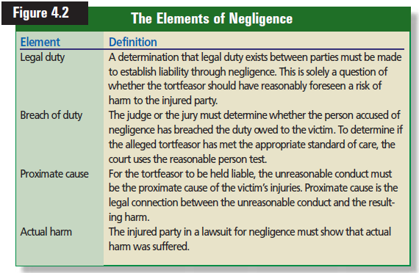
Elements of Negligence

Slide 13
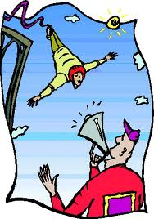
Duty of Care
Relied on someone for their expertise
Breach of Duty
Failure to exercise the degree of care
Proximate Cause
Were the actions of the defendant the cause of the injuries
Actual Harm
Was there physical injuries, property damage or financial loss?
Notes:
What 4 elements must be proven by the plaintiff in a civil trial for negligence?
DUTY OF CARE - the plaintiff must prove that the defendant owed them a duty of care
If somebody owes you a duty of care, this duty of care only applies in areas where you
rely on them. For example, a doctor would owe you a duty of care to make sure that
they give you proper medical attention, but would not owe you a duty of care in other
areas like taking care of your finances.
You cannot take legal action against someone for being negligent unless you suffer
some harm or loss as a result
BREACH OF DUTY - the defendant did not exercise a degree of care that a "reasonable person" would have exercised.
PROXIMATE CAUSE - "The Foreseeability Test" - was the injury to the plaintiff "foreseeable" by a reasonable person, at the time the defendant engaged in the unreasonable conduct?
ACTUAL HARM - the plaintiff must have suffered physical or financial harm to their body or property.
Without actual harm, even the dumbest mistake or the most careless conduct will not result in liability for negligence.
Summary All four elements must be proven by the plaintiff in order to prove negligence. Negligence is classified as an unintentional tort because there is no direct intent to violate an individual's rights. Negligence is different than an accident because in an accident there is no expectation of "reasonable care".

Slide 14
Defenses to Negligence
Eliminating one of the four elements
Contributory Negligence
Behavior by the plaintiff contributes to their injuries
Many states no longer follow this doctrine
Comparative Negligence
Where the negligence of each party is compared
Percentage of negligence is assigned and that percentage is awarded.
Assumption of Risk
Assume the risk of injury as a participant

Slide 15
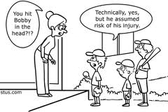

Slide 16
Strict Liability
Activities so dangerous that the law will apply neither the principles of negligence nor the rules of intentional torts.
Participants held liable regardless of how careful
Only applies to ultra-hazardous activities
Housing wild animals or chemicals
Bungee jumping accidents
Does include product liability with imposed limits
Company sells its old machinery and the new user gets hurt using it
Notes:
Injury caused by an individual’s participation in ultrahazardous activity.
STRICT LIABILITY: DEFENSES
• Assumption of Risk: The defendant must show that (i) the plaintiff knew and appreciated the risk created by the alleged product defect, and (ii) the plaintiff voluntarily assumed the risk, even though it was unreasonable to do so. For example, I use a beta computer software program which is clearly labeled and required to be “checked off” as such, and my data is forever destroyed due to a bug in the beta program. Shame on me!
• Product Misuse: The defendant must show that (i) the plaintiff was using the product in some way for which it was not designed, and (ii) the plaintiff’s misuse was not reasonably foreseeable to the defendant, such that the defendant would be required to safeguard against it. For example, I purposefully stand on a trash can to change a light bulb, it caves in, and I am hurt.
• Commonly-Known Danger: The defendant must show that the plaintiff’s injury resulted from a danger so commonly known by the general public that the defendant had no duty to warn plaintiff. For example, using a knife.
• Knowledgeable User: If a particular danger is or should be commonly known by particular users of the product, the manufacturer need not warn those particular users. For example, an electrician using commonly used electric connectors and related materials.

Slide 17
Strict Liability Defenses
Assumption of Risk: The defendant must show that the plaintiff knew and appreciated the risk created by the alleged product defect, and the plaintiff voluntarily assumed the risk,
Product Misuse: The defendant must show that the plaintiff was using the product in some way for which it was not designed, and the plaintiff’s misuse was not reasonably foreseeable to the defendant, such that the defendant would be required to safeguard against it
Commonly-Known Danger: The defendant must show that the plaintiff’s injury resulted from a danger so commonly known by the general public
Knowledgeable User: If a particular danger is or should be commonly known by particular users of the product,

Slide 18
Reviewing What You Learned
What is negligence?
What are the elements of negligence?
What are the major defenses to negligence?
What is strict liability?
Notes:
Negligence is an accidental or unintentional tort
Negligence includes four elements
Duty
Breach of duty
Proximate cause
Actual harm
The defenses for negligence include contributory negligence, comparative negligence, and assumption of risk
Strict liability involves the imposition of liability without fault for injuries caused as the result of engaging in ultra-hazardous activities

