Slide 1
Contracts
What You Will Learn:
How to identify a contract’s elements
How to identify valid, void, voidable and unenforceable contracts
How to distinguish between express and implied contracts
How to distinguish between oral and written contracts
Why It Is Important:
Identifying a contract’s elements will help you manage your affairs in an intelligent and effective manner.

Slide 2
Understanding Contract Law
  Many common daily activities are contracts
    Fast food
    Pumping gas
  You create a contract anytime that you agree to exchange things of value

Slide 3

The Nature of a Contract
  A contract is any agreement enforceable by law.
  Contracts are based upon what the involved parties do and say to one another
  The Three Theories of Contract Law
    Equity Theory
    Will Theory
    Formalist Theory
Notes:
In the past, courts asked whether the parties to a contract exchanged thing of equal value.
This was called the equity theory of contract law.
Industrial capitalism and the need to support a profit-making system forced the courts to shift their focus.
Now the courts whether the parties had agreed to the terms of the contract – called the will theory
Because each party agreed to the contract on their own free will
The courts no longer asked if the contract was fair, but rather “did they really agree to these terms?”
Gradually, this approach led to a search for certain fixed elements to contracts.
If these elements existed, the courts would hold that the contract existed, which led to the formalist theory. That theory relied on the form of the agreement

Slide 4

  The Elements of a Contract
    Offer
    Acceptance
    Genuine Agreement
    Consideration
    Capacity
    Legality
Notes:
OFFER is a proposal by one party to another intended to create a legally binding agreement
ACCEPTANCE is the second party’s unqualified willingness to go along with the first party’s proposal
GENUINE AGREEMENT is when a valid offer is met by a valid acceptance
CONSIDERATION the exchange of things of value
If A signs a contract to buy a car from B for $5,000, A's consideration is the $5,000, and B's consideration is the car.
CAPACITY is the legal ability to enter a contract – usually assumed that anyone entering a contract has the capacity to do so, but can be disputed.
LEGALITY states that one cannot enter into a contract that commits an illegal act

Slide 5
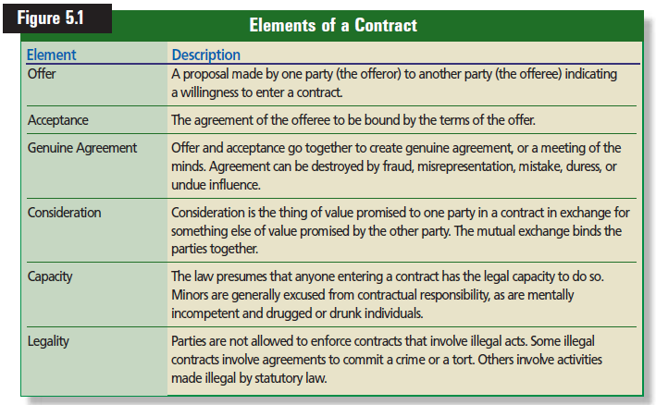

Slide 6
Characteristics of a Contract
  Can be created in different ways and can assume diverse forms
  Valid, Void, Voidable or Unenforceable
    Valid – legally binding or good
    Void – has no legal effect
    Voidable – when a contract can be voided
    Unenforceable – a contract that the court will not uphold
Notes:
Unenforceable contract – court will not uphold due to some law, like statute of limitations.
Waiting too long to bring a lawsuit my make the contract unenforceable

Slide 7


  Express
    Words of the contract are in words
  Implied
    Actions performed by the parties
  Oral or Written
    Contracts created by spoken word are oral contracts.
      One offers to do something and the other offers to do something in return
    Contracts are written in many cases
      Both parties know the exact terms
      Provides proof of the agreement
      Statute of Frauds requires certain contracts be written
Notes:
Express or Implied
Read Example 1 page 111

Slide 8
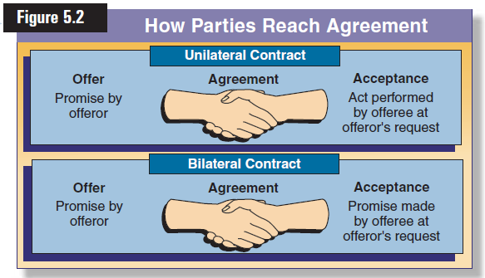
  Bilateral – two sided
    When the contract contains two promises
  Unilateral – one sided
    When a contract only contains the offer and the condition, but no acceptance
    Example are reward posters
Notes:
BILATERAL You offer to sell your old cell phone to a friend for $50. They verbally accept the offer by saying that they will buy it.
UNILATERAL you offer to sell you old cell phone to your friend if they show up tomorrow with $50 before school starts
Lost pet reward posters are unilateral as well

Slide 9
Reviewing What You Learned
  What are the elements of a contract?
  What are the differences among valid, void, voidable, and unenforceable contracts?
  What are the differences between express and implied contracts?
  What are the differences between unilateral and bilateral contracts?
  What are the differences between oral and written contracts?

Slide 10
Offer and Acceptance
What You Will Learn:
How to recognize the requirements of an offer
How to distinguish between an offer and an invitation to negotiate
How to recognize the requirements of an acceptance
How to distinguish between an acceptance and a counteroffer
How to recognize when an offer has terminated
Why It Is Important:
You need to know when an offer has been made and when an acceptance goes into effect to make sound contracts

Slide 11
Requirements of an Offer
  First element of a legally binding contract
  Offers have three requirements
    Made seriously
    Definite and certain
    Communicated to the offeree
Offerer is the party who offers the contract
Offeree is the party to whom offer has been made
Notes:
The six elements are the heart of contract law.
Understanding offer and acceptance is key before moving on to the others

Slide 12


  Serious Intent
    Offer must be made in a serious manner
    An invitation to negotiate is often confused as an offer
      Price tags on items
      Signs in windows
    Exceptions do exist
      Advertisers must use phrases like:
        First come/first served
        Quantities limited
        Makes it an offer not a ITN
Notes:
Must be made with the intention of entering into a legal obligation
An offer made in haste or as a joke would not meet this requirement
“give me five bucks and it’s yours”
It may sound like an offer, but it is not enforceable
Sellers usually have a limited quantity of merchandise to sell and cannot fulfill all requests for products
advertisements are invitations to negotiate rather than offers
Also called invitations to deal, trade, or to make an offer
Read Example #3 page 114
The “I would like to buy a Lava Lamp” was the offer
The storeowner is free to accept or reject the offer

Slide 13

  Definiteness and Certainty
    Terms must be clear and have NO doubt
      Tenant/landlord plumbing fix
      Job offer with “reasonable” commission
  Communication to the Offeree
Notes:
Definite and Clear
Read Example 4 page 115
Not a definite and certain – what is “reasonable”?
Communication to offeree
Read Example 5 page 116
Communication can be made by phone, letter, telegram, fax, email or any other method

Slide 14

Requirements of Acceptance
    Acceptance is the second element of a legally binding contract
  Unconditional Acceptance
    Mirror image rule
    Counteroffer
    Exceptions to the MIR
      Personal property items
      Created by the UCC – uniform commercial code
      Non-merchants – non-regular sellers
      Sales between merchants or B2B sales
Notes:
Unconditional acceptance
Not accepted upon conditions that change the contract. Any changes to the offer means that it was not really accepted.
The offerer is not obligated to go along with the counter offer
Read Example 6 page 117
Sellers and buyers go back and forth until a price is agreed upon and then a contract is written to reflect the negotiated price.
The mirror image rule is when each party writes the same condition in their respective offer and acceptance.
Use the house example
If the parties don’t agree on the sales price, the contract is never a valid contract
B2B conditions
1. the new or different terms do not make a material or crucial difference to the nature of the contract
2. the offeror does not object to the new or different terms within a reasonable time
3. The original offer did not expressly limit acceptance to the terms of the original offer

Slide 15




  Method of Acceptance
    Time limits may be imposed as well
    Offers may be accepted by actions
    Cannot impose silence as means of acceptance
Notes:
The time at which an acceptance takes place is important because that is when the contract comes into existence.
When dealing face to face or over the phone, it is not a problem. One party speaks and the other listens and communicates the offer or the acceptance
Acceptance by mail over long distances a contract comes into existence when it is sent
Common law also states that an acceptance is implied when the offeree accepts by the same or a faster mean than used by the offeror.
Time Limits = the offeror can specify the time by which the acceptance must be received to be effective
Read Example 7 on page 119

Slide 16
Termination of an Offer
  Revocation
    Offer taken off the table by offeror
  Rejection
    Offer rejected by offeree
  Counteroffer
    Negotiating over price – one contract ends and another one starts
  Expiration of Time
    Must accept offer before a set time passes
    Option contract
  Death or Insanity
Notes:
Revocation is when the offer is taken back by the offeror
Two conditions:
Can be revoked any time before acceptance
Become effective upon communication to the offeree
Read Example 8 page 120
Rejection is when the offer is rejected by the offeree
Read Example 9 on page 120
Counteroffer is when the offeror and the offeree haggle back and forth on conditions of the contract
Expiration of Time is when the offeror sets a time limit for the acceptance of the offer.
Option contract is when the offeree pays the offeror to hold the offer for an agreed period of time.
Option contract requires and absolute, unconditional, unqualified acceptance exactly according to the terms of the option.
Death or Insanity is when the offeror dies or becomes insane before acceptance of offer occurs
Death may end an offer but does not end a contract, unless it is for personal services

Slide 17
Reviewing What You Learned
  What are the requirements of an offer?
  What is the difference between an offer and an invitation to negotiate?
  What are the requirements of an acceptance?
  What is the difference between an acceptance and a counteroffer?
  When is an offer terminated?

