Slide 1
Fraud and Misrepresentation
What You Will Learn:
How to identify the elements of fraud
How to distinguish between fraud and concealment
How to distinguish between fraud and innocent misrepresentation
How to distinguish between the remedy available for fraud and the remedy available for misrepresentation
Why It Is Important:
Learning the elements of fraud may prevent you from being victimized or help you claim your rights if you are defrauded

Slide 2
Defective Agreements
Something goes wrong
What you thought was a valid contract is nothing of the such
Agreement is defective
Fraud
Misrepresentation
Mistake
Duress
Undue influence
Notes:
How is Genuine Agreement achieved?
When a valid offer is accepted
Courts describe this type of agreement a “meeting of the minds”
Making the assumption that the other three elements of the contract are in place
Consideration
Capacity
Legality

Slide 3
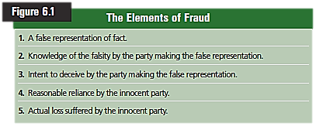
These 5 elements must be present to succeed in a fraud lawsuit
Fraud
Is the deliberate deception intended to secure an unfair or unlawful gain.
You were talked into entering a contract
Rescind the contract or sue for money damages
Deliberate deception may lead to punitive damages
Award money greater then the amount needed to pay back
Notes:
-There must be a false representation of fact
-The party making the representation must know it is false
-The false representation must be made with the intent that it be relied upon
-The innocent party must reasonable rely upon the false representation
-The innocent party must actually suffer some monetary loss
punitive damages awarded to each plaintiff is not only an attempt to punish the hotel for its misconduct, or to deter it from future failure to properly exterminate, but also, or perhaps instead, an attempt, albeit an imperfect one, to effect societal compensation.
Types of criminal fraud include:
bait and switch
bankruptcy fraud
benefit fraud, committing fraud to get government benefits
counterfeit
charlatanism (psychic and occult),
confidence tricks such as the 419 fraud and Spanish Prisoner
selling counterfeit goods which are not what they claim to be, e.g., designer clothing, fake works of art, archaeological objects, etc.
creation of false companies or "long firms"
embezzlement, taking money which one has been entrusted with on behalf of another party
false advertising
false billing
false insurance claims
forgery of documents or signatures,
health fraud, for example selling of products known not to be effective, such as quack medicines,
identity theft
investment frauds, such as Ponzi schemes and Pyramid schemes
Religious fraud
marriage fraud to obtain immigration rights without entitlement
rigged gambling games such as the shell game
securities frauds such as pump and dump
taking payment for goods ordered with no intention of delivering them
tax fraud, not reporting revenue or illegally avoiding taxes (tax evasion). Iin some countries tax fraud is also prosecuted under false billing or tax forgery
False Advertising and Consumer Fraud
False advertising is one of the most common forms of consumer fraud. Such fraud often results when misleading statements are made in an advertisement in an attempt to over-hype a product or service. For example, if a LASIK service guarantees 20/20 vision, and a customer's vision is only 20/30 following a procedure, then this could be considered false advertising.

Slide 4
False Representation of Fact
Material Fact
Is a fact that is important
Matter to one of the parties
Cannot be a promise of future actions or an opinion
Not limited to oral or written statements
Actions intended to deceive
Concealment
Is when chooses not to reveal important information
Also called passive fraud or nondisclosure
Hidden problems in a house
Notes:
Material Fact:
The law does allow for some “sales talk”
“this car is really flashy” is an opinion
“you will get plenty of dates with this car” is an opinion and a promise of future action
Concealment
Sellers disclosure doco for real estate
If the sellers know about a problem that is not readily seen by the buyer, they have the duty to disclose. The buyer is relying on the sellers knowledge about the subject

Slide 5
Representation Known to be False
The party making the false representation must be aware that the representation is false
Statement made without regard for the truth
Notes:
Read Example 1 on page 130

Slide 6
False Representation Intended to Be Relied Upon
The person making the misrepresentation must intend that the other party will rely on the information as part of negotiations
False Representation Actually Relied Upon
When someone uses misrepresented information as part of negotiating a contract
Resulting Loss
Actual monetary loss must have resulted
Notes:
False Representation Intended to be Relied Upon
Example 2 on page 131
False Representation Actually Relied Upon
Example 3 on page 131
Resulting Loss
If you purchased a used CD player that the seller told you it was “in perfect working condition” and you find out that is was not, you have lost what you paid for the CD player and can sue on the basis of fraud.
If you received the CD player in exchange for a favor, since you suffered no monetary loss you do not have a fraud case/.

Slide 7
Innocent Misrepresentation
Sometimes a person will make an innocent statement that turns out to be false.
Honestly believed that statement was true at the time it was made.
The law give you the right to rescind the contract
Damages not awarded

Slide 8
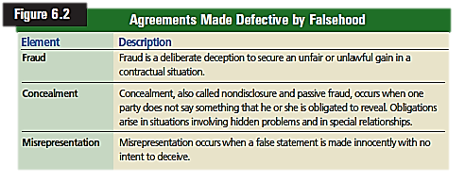

Slide 9
Reviewing What You Learned
What are the elements of fraud?
What is the difference between fraud and concealment?
What is the difference between fraud and innocent misrepresentation?
What is the difference between the remedy available for fraud and the remedy available for misrepresentation?

Slide 10
Mistake, Duress, & Undue Influence
What You Will Learn:
How to distinguish between unilateral and bilateral mistake
How to recognize the types of mistake that will allow rescission of a contract
How to recognize the requirements of economic duress
How to recognize the requirements of undue influence
Why It Is Important:
Recognizing how mistake, duress, and undue influence can affect agreements will help you make better decisions in such situations

Slide 11
Mistake
Unilateral Mistake
Is a mistake on the part of one of the parties to the contract
Reasonable expectations should not be blocked because of a mistake
http://public.findlaw.com/abaflg/flg-9-1b-10.html
Mistake as to the Nature of the Agreement
What exactly did you agree too?
If you don’t understand the language, bring someone who does and can explain it.
Mistake as to the Identity of a Party
Making the contract to the wrong person.
Notes:
The purpose of contract law is to fulfill the reasonable expectations of the parties to a contract.
People sometimes enter into contracts believing that certain information is true when it is actually not, or visa-versa
Unilateral Mistake Read Example 5 on page 133
You sign a contract to mow the neighbors lawn at least once a week, through the summer.
Your oral agreement was every other week.
Your are obligated to your written contract.
Your signature shows that you are unconditionally agreeing to the terms outlined in the contract.
What is a Unilateral mistake? An error on the part of one person to a contract. A person cannot get out of a contract because they made a mistake.
What are two types of Unilateral mistakes ? Mistake as to the Nature of the Agreement - Failure to read the contract, or the failure to understand the language used in the contract, is no excuse.
Mistake as to the Identity of Party - may cause a contract to be void when you are not dealing in a face to face manner. However, When dealing face to face, a mistake in identity is no excuse.
What is Bilateral Mistake ? A mutual mistake by both parties. Either party can avoid the contract.
Mistake as to the identity
Read Example 6 on page 134

Slide 12
Bilateral Mistake
Sometimes both parties involved in a contract make mistakes.
Contract is voidable by either party
Mistake as to the Possibility of Performance
Something happens that will not allow the contract to be completed
Mistake as to the Subject Matter
When both parties are mistaken as to the identity of the subject matter
Contract may be voided
Notes:
Mistake as to the Possibility of Performance
Read Example 7 on page 136
Mistake as to the Subject Matter
Read Example 8 on page 136

Slide 14
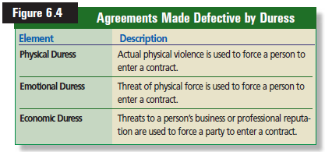
Duress
Influencing a person’s will by use of force or threat
Physical or Emotional Duress
Agreements made under duress are void or voidable
Mob offering protection to merchants
Threat made against the party of a member of their family
Economic Duress
Is the threat of a person’s business or income as establishment of a contract.
Notes:
Remember, contracts are to be entered into willingly, not by force.
When actual physical force is used to establish a contract , that contract is void
When physical harm is threated to establish a contract, that contract is voidable
Economic Duress
Read Example 9 on page 137
Using a threat to exercise one’s legal rights is not duress. You can threaten to protest a business unless they honor the contract in which they entered with you.

Slide 15
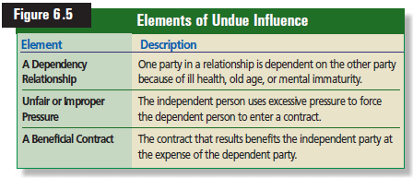
Undue Influence
Is when one person used unfair and improper persuasive pressure to force someone else into a contract
Ill health
Old age
Mental instability
The stronger persons substitutes his will for the will of the weaker person
Notes:
Undue Influence
Read Example 10 on page 139

Slide 16
Reviewing What You Learned
What is the difference between unilateral and bilateral mistake?
What types of mistake will allow rescission of a contract?
What are the requirements of economic duress?
What are the requirements of undue influence?

