Slide 1
A Dual Court System
What You Will Learn:
How to determine a court’s jurisdiction
How to explain the structure of the federal court system
How to explain the role of the US Supreme Court
How to explain the structure of the state court system
How to describe the difference between a juvenile who is unruly and one who is delinquent
Why It Is Important:
Learning the structure of the court systems in the United States will help you understand how the legal system works

Slide 2
The Federal Court System
Federal level and state level courts
Jurisdiction is the power and authority given to a court to hear cases and make judgment
Actions where the US or one state is a party – except where it is between a state and a citizen
Federal questions – interpreting the Constitution
Diversity of Citizenship – different states and >$75,000
Admiralty cases – at sea
Patent and copyright cases
Bankruptcy cases

Slide 3
Example: Local police of a large city caught a woman breaking into a federal government building. The police arrested the woman, but because the crime was committed against federal property, she was turned over to federal authorities for trial in the federal district court.

Slide 4
Federal courts are arranged in three steps:
District Courts
Original jurisdiction – they try the case the first time that it is hear
Courts of Appeals – appellate courts
Appellate jurisdiction – they hear appeals and review cases from the district courts
13 circuits
Panel of 3 judges – answers question of law at this level
Did the district court apply the law properly?

Slide 6
Special U.S. Courts
Established by congress
Handle cases brought by citizens against the federal government
Taxes on imported goods
Disputes between taxpayers and the IRS
Supreme Court – highest court
Has original jurisdiction in cases in which the state is a party.
Main function is appellate jurisdiction
Must hear all cases that questions constitutionality of a federal law
Chooses which cases it will hear – 4 out of 9

Slide 7
State Court Systems
Local Trial Courts
Limited jurisdiction – only handle misdemeanors and civil actions involving small amounts of money
Magistrate’s – tried small claims and punished petty crimes
Traffic courts / police courts / municipal courts
Juveniles / family disputes / small claims
General Trial Courts
General jurisdiction – county level courts
Handle criminal and civil cases

Slide 8
Delinquent Child – a minor under a certain age (generally 16-18) who has committed an adult crime.
Unruly child – is generally a minor who has done something inappropriate that is not considered an adult crime.
Special Courts
Set up to handle specialized cases
Probate, adoptions, and traffic violations
Domestic Relations
handles divorce, annulment, and dissolution proceedings
Distribution of property, child support, and alimony
Juvenile Courts
Delinquent vs. Unruly
Neglected or Abused
Notes:
States have imposed stricter standards for younger offenders – drugs and violence.
Some states say that 14 is the old enough to be tried as an adult

Slide 9
Intermediate Appellate Courts
Hears the appeals from courts of general jurisdiction.
Lack of fair trial
Law not properly interpreted
Questions of laws not facts
Oral arguments from attorneys
Example #2 – Bill sued Steve for injuries suffered when they had a car accident. The case was tried in a county court, and the court found in favor of Steve. Bill’s lawyer must look for errors in the court’s interpretation of the law or the conduct of the trial to file an appeal.

Slide 10
Supreme Courts
Are the highest courts in the states.
Decides matters of law appealed from lower courts
Don’t retry cases or listen to facts
Look for errors made by lower courts
Choose the cases it will hear

Slide 11
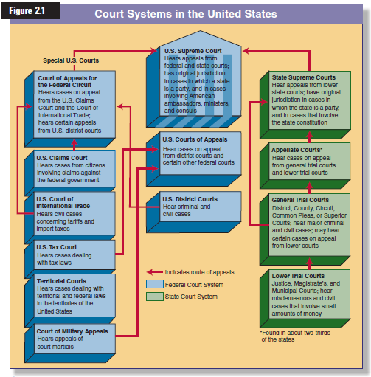

Slide 12
Reviewing What You Learned
What is the difference among the four jurisdictions?
Original
Appellate
Limited
General
How are the federal courts structured?
What is the role of the U.S. Supreme Court?
How are most courts structured?
Explain the difference among unruly, delinquent, and abused or neglected juveniles
Notes:
Original jurisdiction = the court that hears the case for the first time
Appellate jurisdiction = court

Slide 13
Trial Procedures
What You Will Learn:
How to seek alternatives to litigation
How to differentiate between civil and criminal cases
How to explain the steps in a civil lawsuit
How to exercise your rights if arrested
How to explain the steps in a criminal prosecution
How to apply court procedures to juvenile cases
Why It Is Important:
Learning the alternatives to litigation will help you handle disputes that arise

Slide 14
Civil Trial Procedure
Alternative Dispute Resolution
parties try to resolve differences out of court
quicker and less expensive
Reactive Methods
Used after a dispute has arisen
Makes use of summary trial
Proactive Methods
Used before a dispute arises
business dealings – partnership agreements
Notes:
Criminal and civil trial begin differently
Govt brings criminal cases for offenses committed against the public at large
Individuals files a complaint with the courts, gets a lawyer

Slide 15
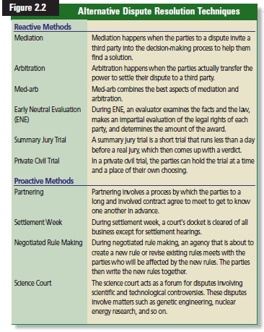

Slide 16
Pleadings
Formal papers filed with the court by the plaintiff and defendant
Complaint is filed by the plaintiff
Answer is the defendant’s response
Facts are brought out before the trial – methods of discovery
Depositions, documents, other evidence, physical & mental exams, and admission
Not settled at this point – placed on court docket

Slide 17
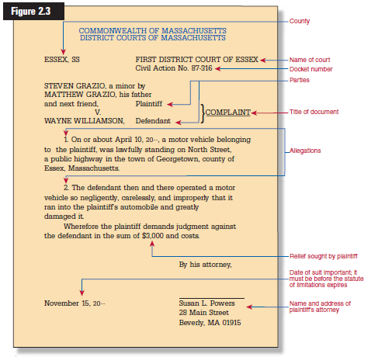

Slide 18
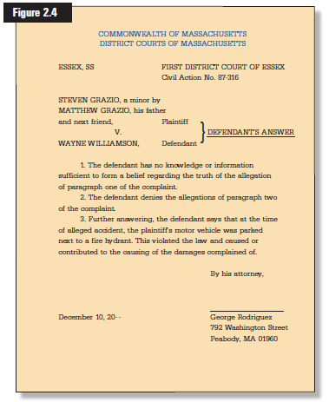

Slide 19
Pretrial Hearing
Happens before the trial
Informational meeting before a judge
Used to simplify issues & discuss matters that might help dispose of the case

Slide 20
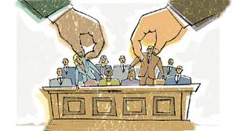
Steps in a Jury Trial
Selecting a Jury
drawn from a pool of citizens
Each lawyer questions jurors
Jury determines the facts of the case
Applies the law to those facts

Slide 21
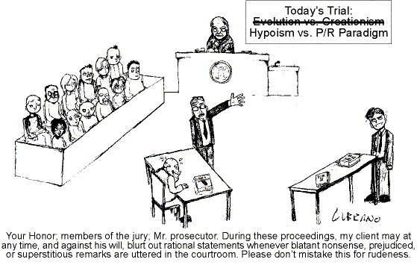
Opening Statements
After jurors are selected
Each side “tells their side of the story”
Plaintiff goes first
Defendant may delay their opening statement until after the plaintiff presents its evidence

Slide 22
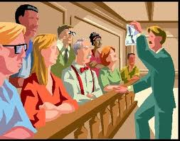
Introduction of Evidence
Plaintiff presents all of their evidence
Witnesses respond to subpoena (order to appear)
Expert opinions
Defense attorney can cross-examine
Defense presents favorable evidence
Plaintiff may cross examine
Both will rest their cases when all evidence has been presented

Slide 23
Closing Arguments
Plaintiff goes first
Summarizes evidence
Each presents reasons to favor their client
Instructions to the Jury
Judge will explain the law to the jury
Attorneys from both sides may suggest instructions

Slide 24
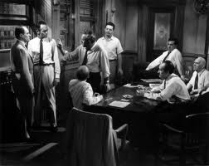
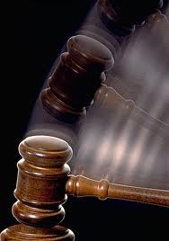
Verdict and Judgment
Jury meets in the jury room
Deliberates the verdict
Influenced by evidence
Finds “in favor of”
States vary on number of jurors for decision
Mass. only needs 5/6
Court issues a judgment

Slide 25
Remedies
Specific performance
when the plaintiff may want the defendant to do what was promised in a contract
Injunction
Is when the plaintiff wants to prevent the defendant from doing something in the future.
Also called an “order to stop”
Notes:
When a defendant is found liable in a civil trial, the plaintiff is entitled to a remedy or payment – made whole

Slide 26
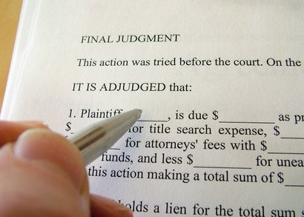
Execution of Judgment
After trial determines the winning and losing party, the judgment must be carried out
Defendant may have to pay plaintiff.
Winning party may have to return to court to enforce the judgment
Property may have to be seized.

Slide 27
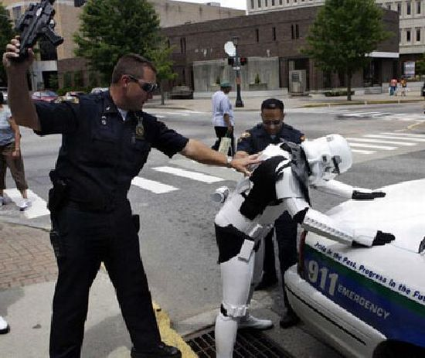
Criminal Trial Procedure
Starts with the arrest of the defendant
Immediate hearing to protect rights
Trial is scheduled

Slide 28
Arrest of the Defendant
Occurs when a person is deprived of his or her freedom
Rights of the defendant – Miranda Rights
Must be informed of the crime you have committed
Phone call
May be released on bail
Right to remain silent
Right to an attorney
Right to a fair trial
Notes:
Police may arrest a person at anytime if they have a warrant.
May arrest without a warrant if believed that the person has committed or is in the process of committing a felony or a misdemeanor involving the breach of the peace while in the officers presence

Slide 29
Search and Seizure
Police may search only if permission is given or warrant issued
Limited to the area mentioned.
Limited search for weapons
Arrested person may be searched without a warrant
Cars and buildings
Items in plain view may be seized
1991 US Supreme court ruled that closed containers and bags may be opened during a search
Notes:
For Example, in 1976, police impounded a car for parking violations. While making a list of contents, they found a bag of marijuana and charged the owner with possession. Ruled constitutional because it is standard procedure to list the contents of every car impounded

Slide 30
The Arraignment
Brought to court as soon as possible
Judge may decide there is probable cause to go to trial or dismiss the case
Case presented to a grand jury.
Grand jury determines if someone should stand trial. Petit jury decides quilt or innocence
If a crime was committed an indictment is issued
Indictment does not mean guilt, but the possibility of guilt
Suspect is read the indictment
Pleads innocent or guilty
Guilty = sentence
Not guilty = proceed to trial.

Slide 31
The Trial
Case can be tried by a judge
Defendant requests a jury trial
Jury selection
Opening statements
Evidence presented
Closing statements
Instructions to the jury
Jury verdict must be unanimous
Guilty beyond a reasonable doubt
Not guilty
Mistrial – jury can not agree

Slide 32
Sentencing
If found guilty the judge will decide the punishment
Fine Imprisonment Death
Fine is a payment of money as a penalty
Fines can be levied along with imprisonment
Imprisonment
Each state is different – minimum and maximum.
5 to 10 years
Indefinite vs. definite
Death penalty
Jury determines guilt
Judge or jury listens to arguments during presentencing
Appeal is taken to the state’s highest court

Slide 33
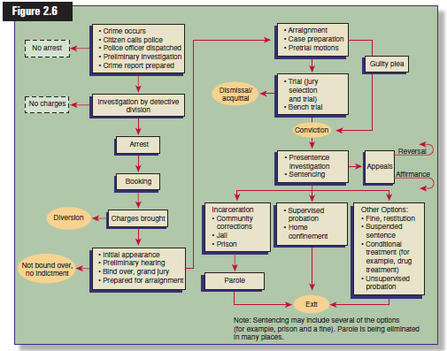

Slide 34
Disposition of Juvenile Cases
Cases involving juveniles
Each case and special circumstances are considered individually
Detention hearing
Used to determine if the accused should be held
Background investigation
Charges may not be serious enough
Cases settled in one of three ways
Probation
Agency or foster home
Training or reform school

Slide 35
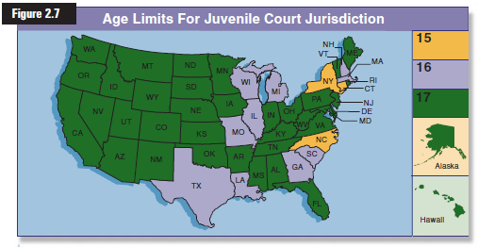

Slide 36
Reviewing What You Learned
What are some alternative to litigation?
What is the difference between a civil case and a criminal case?
What are the steps in a civil lawsuit?
How can people exercise their rights when they are arrested?
What are the steps in a criminal prosecution?
How do the courts treat juvenile cases?

